Slide 1












BCS3143
24/25-I
SOFTWARE PROJECT MANAGEMENT
Mohammad Farid Hendianto
CB24153
Github
+62 857 1761 1301
IRedDragonICY
Contact
hendik.Suwoto@gmail.com

Slide 2












PERSONAL INFO
Gazzz
02
HOMETOWN
HOBBY
FAVORITE MOVIE
South Tangerang City, Indonesian
Drawing
and
Gaming
Watching Anime
Mission: Finishing SPM

Slide 3

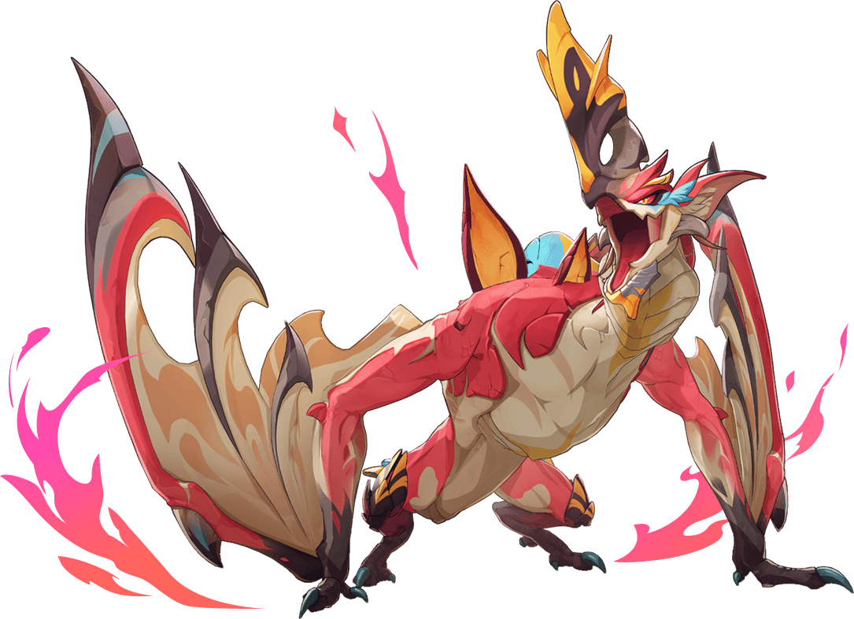








PROPOSED APPS
03
V.I.X.E.V.I.A.
Virtual Interactive and Xpressive Entertainment Visual Idol Avatar
An AI-powered Virtual YouTuber (Vtuber) utilizing Google's Gemini language model to create engaging, personalized, and context-aware interactions.
Make Anime real with AI!!!
Powered with Gemini 1.5 Pro*

Slide 4





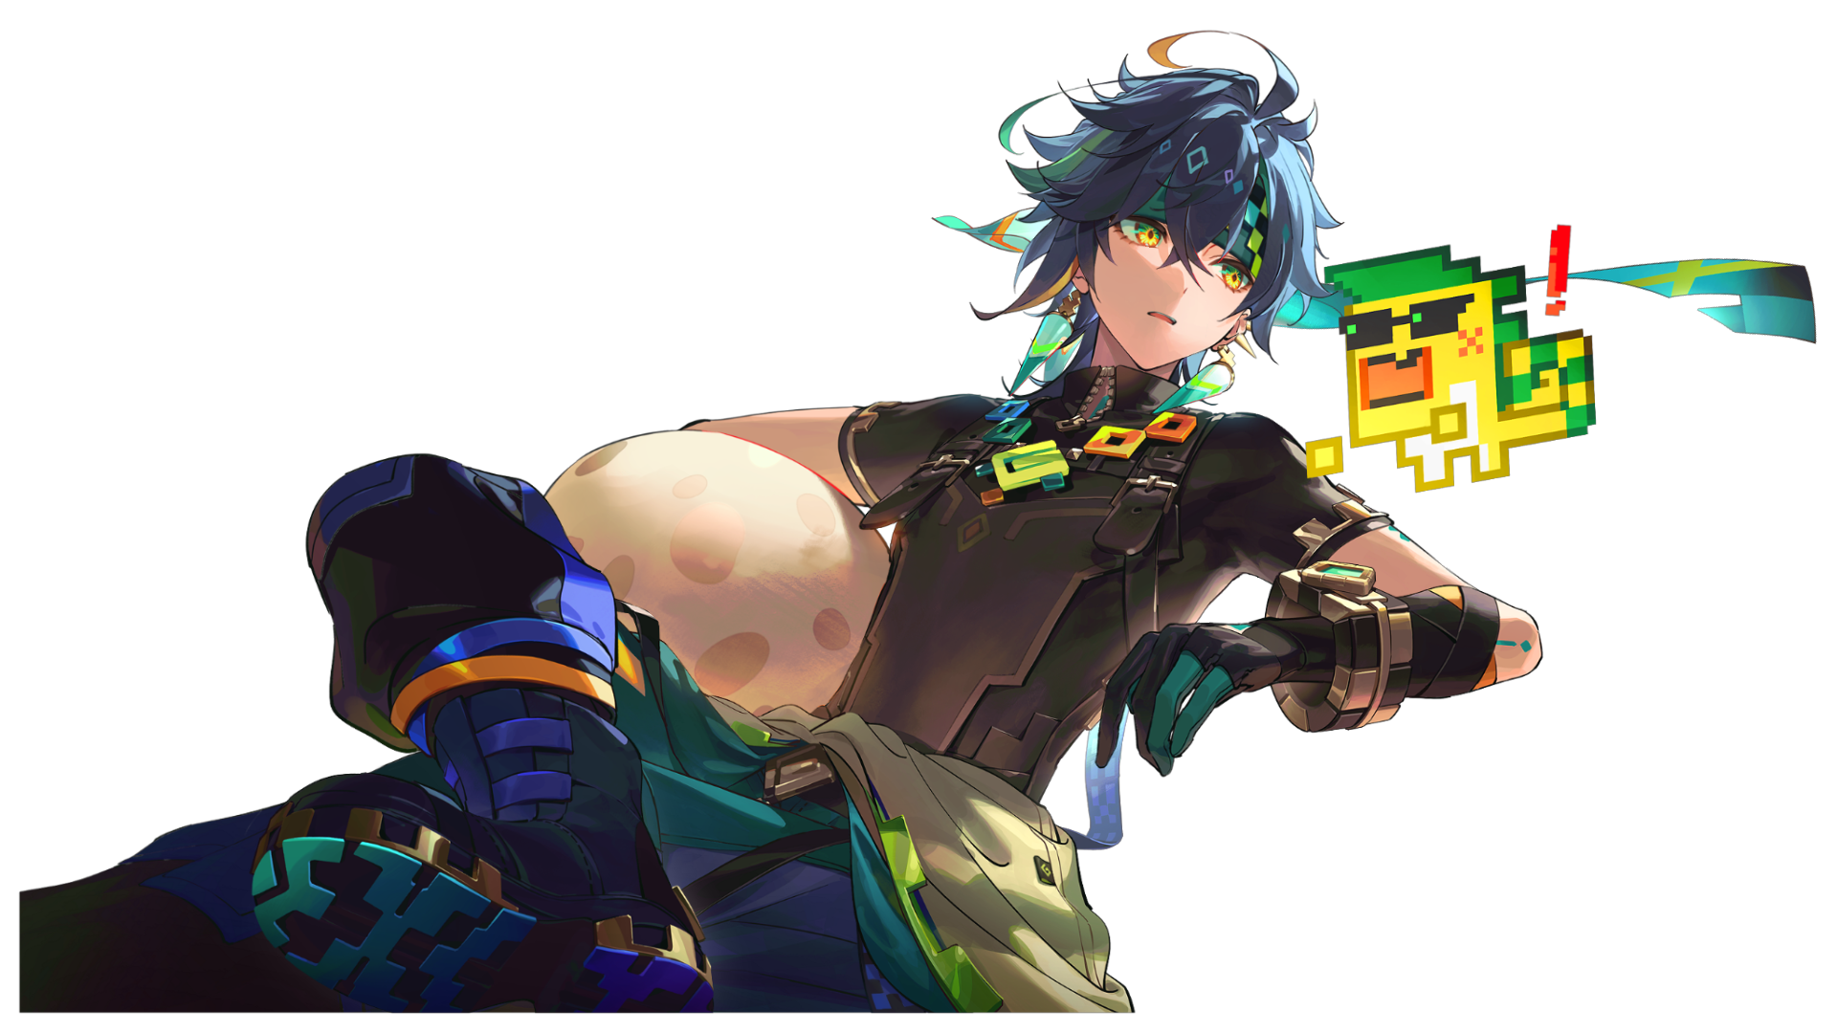




04
PROJECT MISSION
To move on after breakup
To create a captivating and lifelike virtual personality that can engage with users through natural conversations, visual interactions, and multimedia experiences.
To make Waifu real with AI based

Slide 5




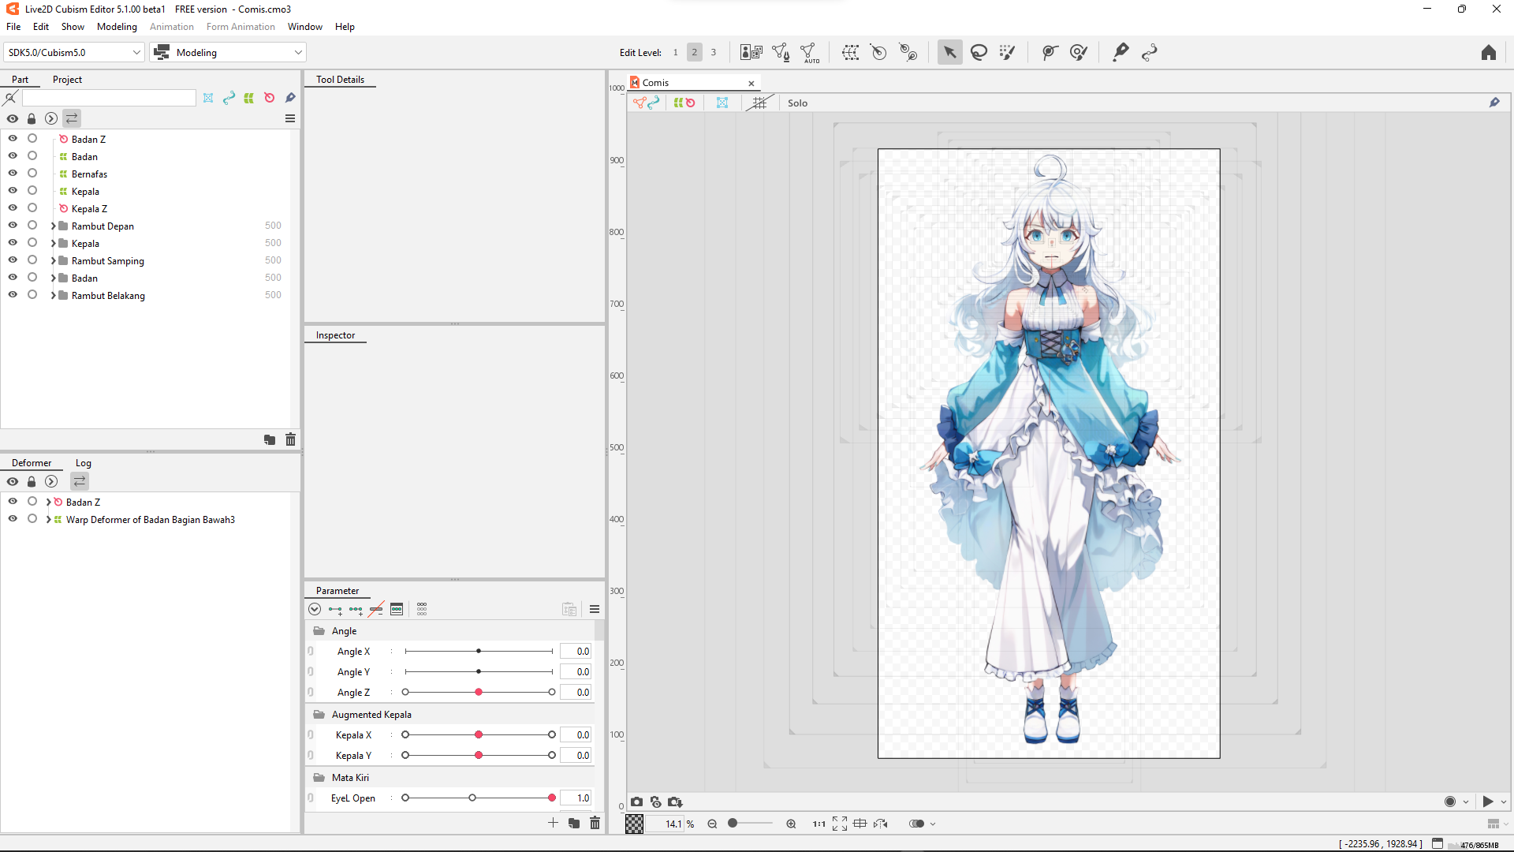

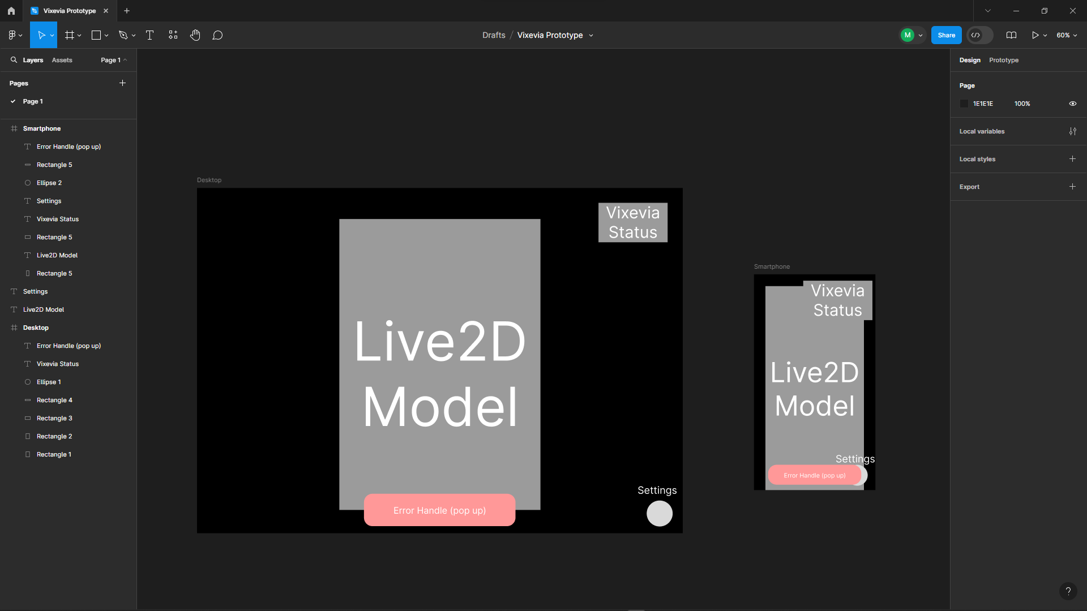
PROJECT TIMELINE, COST & STAKEHOLDERS
05
Period/Time
Stakeholder
5 Months
Project Developers
Google Cloud Platform
User and Community
Open Source
Hardware Provider
Stakeholder
2.000 $

Slide 6












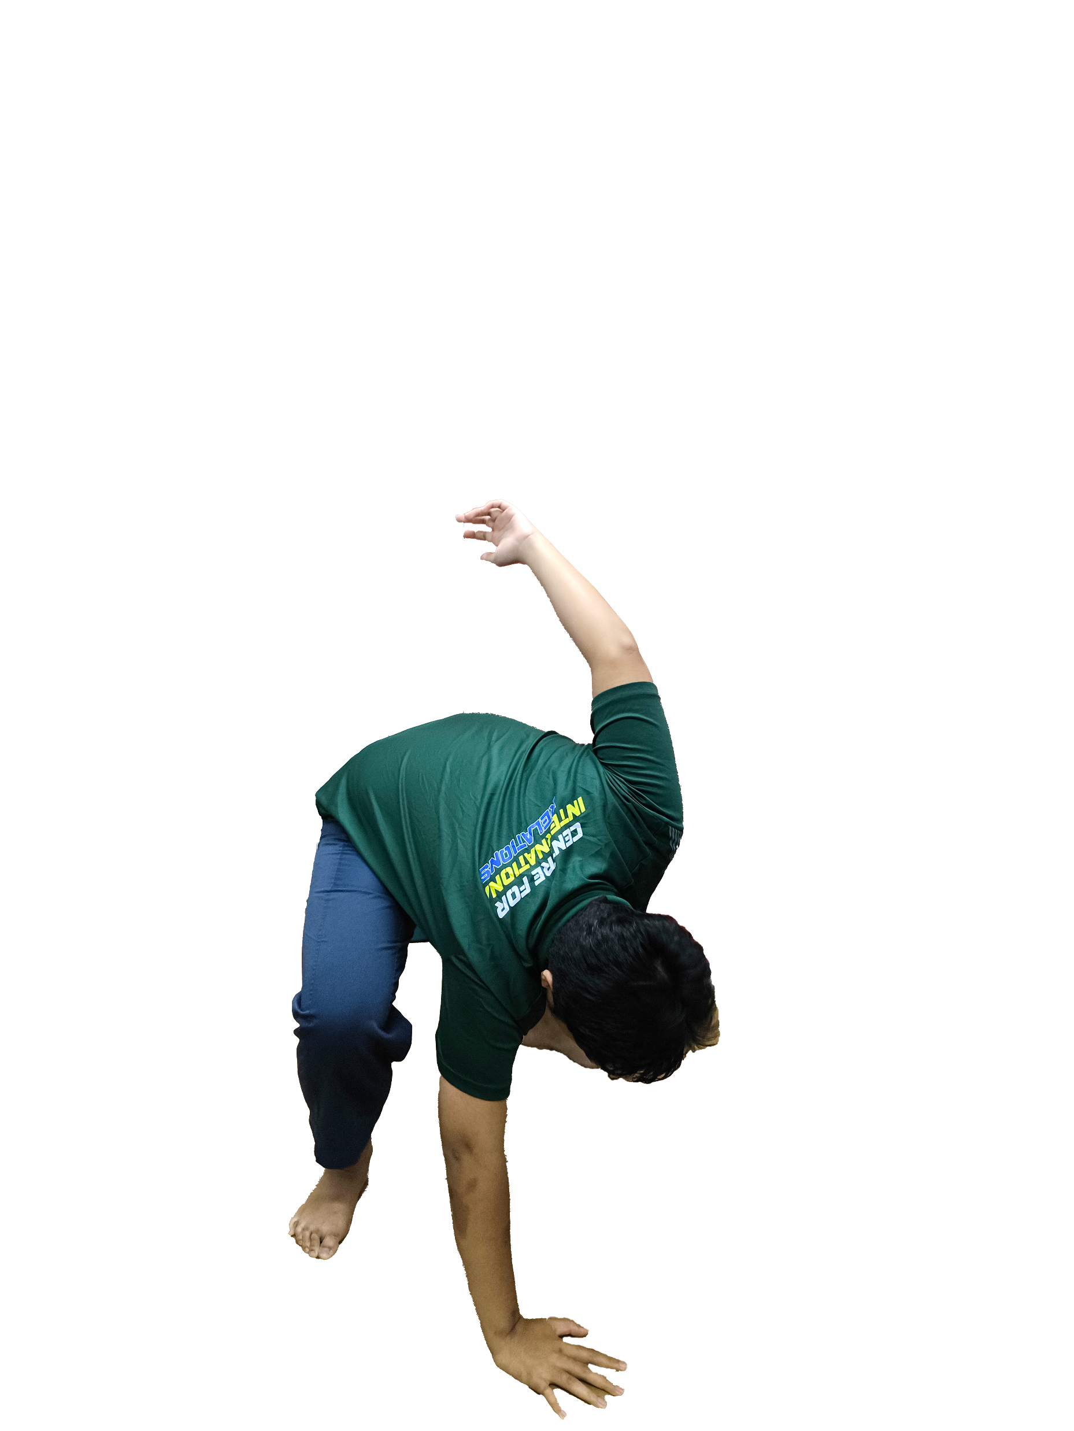






Kakkoii!
06
WAR CRY & CHEERS
V.I.X.E.V.I.A.
AI VTuber
口寄せの術!!!
Poff

Slide 7




5 STAKEHOLDERS
WHY THEY INVOLVE IN THIS PROJECT
07
Project Developers:
The founders of V.I.X.E.V.I.A that makes exist right now.
Google Cloud Platform:
Provides the infrastructure and tools, such as the Google Gemini model.
User and Community:
The end-users and Weebs community play a role in testing and providing feedback.
Open Source:
Being an open-source project under the MIT license, external developers can access and contribute.
Hardware Provider:
Essential for providing the GPU and other hardware components needed to run the complex AI processes and ensure smooth rendering and real-time functionality of her.

Slide 8
Stakeholder
People who involved in developing the system:
People are affected by the system directly and indirectly

